Slide 1
Sentiment Analysis : Customer Survey Data
Ankita Guha

Slide 2
Agenda
INTRODUCTION 3
SETTING UP DIRECTORY 4
HANDS ON WORKSHOP : DEMO
SUMMARY : TEXT PROCESSING 5
LIBRARIES 6
NLP & AI : REFERENCE & ADDITIONAL REFERENCES 7

Slide 3
Introduction
Customer Survey Data
Survey Questions :
What are we doing well ?
How can we do better ?
Language : R
To Download R, you can visit: RStudio Desktop - Posit

Slide 4
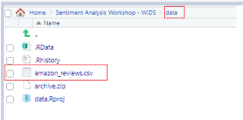
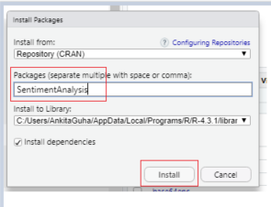
Setting Up Directory
Download the Data Source from Kaggle.
Next set up a Directory with the Data Source:
Install Packages either from Console by typing install.packages(“libraryname”) or from the GUI Packages tab and then click Install and type the package name:

Slide 5
Summary : Text Mining, NLP & Sentiment Analysis
Reiterate the Text Preprocessing :
Convert to Lower Case
Remove Punctuation
Remove Stopwords
Stemming Documents
Bar Chart > Top 20
Word Cloud > Top 100
Frequency & Lollypop Chart > Word-Grams, Tokens
Combine & Compare the Corpus/es
Check the Common Words appearing in the Corpus/es : Correlation
Sentiment Analysis : [with Vector Source & with Corpus]
Dimension Reduction using Hierarchical Clustering : Dendrograms
Take Home : Emotional Analysis

Slide 6
Library Used | Definition
diana | Divisive clustering of a dataset
agnes | Agglomerative clustering of a dataset
cluster | Finding groups is data
factoextra | Extract & Visualize the results of Multivariate data analysis
tidytext | Tokenization, n-grams, word counts, stopwords
janeaustenr | One-row-per-line format, one-token-per-row
stringr | Perform string operations
tm | Text data manipulation
wordcloud | Visualize documents in bag of words
plotrix | Plotting, labeling, axis and scaling functions
dendextend | Applies customization to Dendrogram Visuals
reshape2 | Data transformation in wide and long formats
quanteda | Text data manipulation

Slide 7
References
Data Source : amazon reviews for sentiment analysis | Kaggle
Sentiment analysis with tidy data | Text Mining with R (tidytextmining.com)
Introduction to tidytext (r-project.org)
Introduction to the tm Package Text Mining in R
R: Agglomerative Nesting (AGNES) Object (ethz.ch)
R: DIvisive ANAlysis Clustering (ethz.ch)
SentimentAnalysis: Dictionary-Based Sentiment Analysis (r-project.org)
SentimentAnalysis Vignette (r-project.org)
Basic graphics in R (ashki23.github.io)

Slide 8
Additional Resources
VADER-Sentiment Analysis
Summarize a paragraph | MakerSuite (google.com)
Models - Hugging Face
Text and natural language processing with TensorFlow | TensorFlow Core

Slide 9
Thank You! ☺
If you have any questions or concerns, please feel free to reach out to me on my social handles below.
GitHub
LinkedIn
Medium

